Slide 1

Semi Supervised Machine Learning approach for Detecting DDoS Attack
Batch No: A-08 Project Guide:
C.Lavanya (164G1A0547) Mr. B.Sreedhar, M.Tech.
B.Chandrika (164G1A0518) Assistant Professor`
K.N.V.Kishore Kumar (164G1A0538)
T.Kumuda (164G1A0542)
Srinivasa Ramanujan Institute of Technology
Department of Computer Science & Engineering

Slide 2
Questions from review 1
What is source of dataset ?
How many number of features in dataset ?
What is the conclusion of your project ?

Slide 3
Abstract
Existing ML-based DDoS detection approaches are under two categories: supervised and unsupervised.
Supervised ML approaches for DDoS detection rely on availability of labeled network traffic datasets.
Whereas, unsupervised ML approaches detect attacks by analyzing the incoming network traffic.
Both approaches are challenged by large amount of network traffic data, low detection accuracy and high false positive rates.

Slide 4
Problem Definition
A distributed denial-of-service (DDoS) attack is a malicious attempt to disrupt normal traffic of a targeted server, service or network by overwhelming the target or its surrounding infrastructure with a flood of Internet traffic.
DDoS attacks target websites and online services.
Most famous recent DDoS attack happened on GITHUB(February,2018)
For Detecting this problem we are proposing a new solution by using semi supervised machine learning approach.

Slide 5
Existing System
The existing Machine Learning based DDoS detection approaches can be divided into two categories. Supervised ML approaches that use generated labeled network traffic datasets to build the detection model. Two major issues are facing the supervised approaches.
First, the generation of labeled network traffic datasets is costly in terms of computation and time.
Second, the the presence of large amount of irrelevant normal data in the incoming network traffic is noisy and reduces the performances of supervised ML classifiers.

Slide 6
Contd…
Disadvantages of existing system:
The main drawback of the unsupervised approaches is the high false positive rates.
The supervised machine learning approaches are unable to predict the new legitimate and attack behaviors

Slide 7
Proposed System
It is online semi-supervised ML approach for DDoS detection based on network Entropy estimation, Co-clustering and Extra-Trees algorithm.
The unsupervised part of the approach allows to reduce the irrelevant normal traffic data for DDoS detection which allows to reduce false positive rates and increase accuracy.
Whereas, the supervised part allows to reduce the false positive rates of the unsupervised part and to accurately classify the DDoS traffic.

Slide 8
Literature Survey
1.Idhammad M, Afdel K, Belouch M (2017) Dos detection methodbased on artificial neural networks. Int J Adv Comput Sci Appl(ijacsa) 8(4):465–471.
DoS attack is a major Internet security problem-DoS is that lots of clients simultaneously send service requests to certain server on the internet such that this server is too busy to provide normal services for others. Attackers using legitimate packets and often changing package information, so that traditional detection methods based on feature descriptions is difficult to detect it. This paper present an artificial intelligence DoS attack detection method based on neural networks. In this method, analysis of server resources and network traffic, To training the ability of detection normal or abnormal, it have better results for detect DoS attack.
https://thesai.org/Downloads/Volume8No4/Paper_61-DoS_Detection_Method_based_on_Artificial_Neural.pdf

Slide 9
Contd….
2.Papalexakis EE, Beutel A, Steenkiste P (2014) Network anomaly detection using co-clustering. In: Encyclopedia of social network analysis and mining. Springer, Berlin, pp 1054–1068.
The prevalence of Internet attacks has increased significantly, but still the challenge of detecting such attacks generally falls on the end hosts and service providers, requiring system administrators to detect and block attacks on their own. In particular, as social networks have become central hubs of information and communication, they are increasingly the target of attention and attacks. This creates a challenge of carefully distinguishing malicious connections from normal ones. Previous work has shown that for a variety of Internet attacks, there is a small subset of connection measurements that are good indicators of whether a connection is part of an attack or not. In this paper we look at the effectiveness of using two different co-clustering algorithms to both cluster connections as well as mark which connection measurements are strong indicators of what makes any given cluster anomalous relative to the total data set.
https://www.cs.ucr.edu/~epapalex/papers/ASONAM2012.pdf

Slide 10
Planning
Task | Date
Software Installation | 20/01/2020
Front end Development | 20/02/2020
Back end Development | 30/03/2020
Documentation and Verification | 10/04/2020

Slide 11
Requirements
Hardware Requirements:
Processor : Intel coreI3
Operating System : Windows 10
Software Requirements:
Backend : Python
Frontend : HTML,CSS
IDE : Pycharm

Slide 12
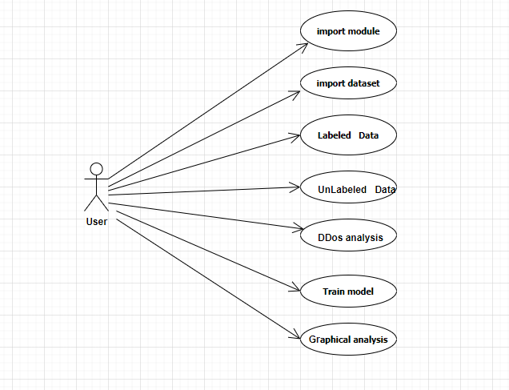
Design
Usecase diagram

Slide 13
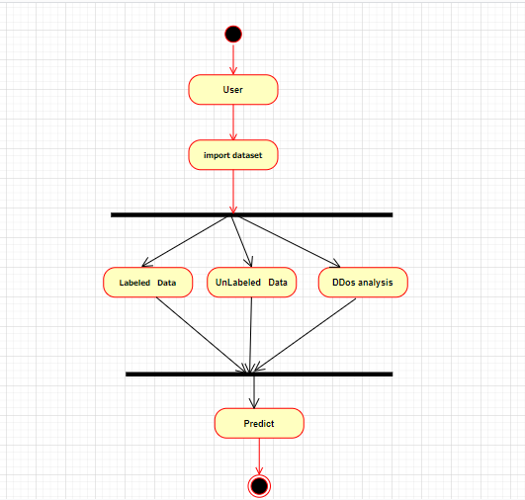
Activity diagram

Slide 14
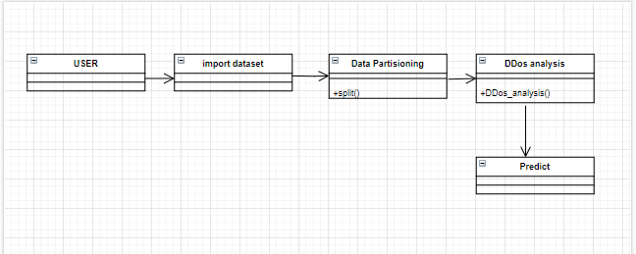
Class Diagram

Slide 15
Implementation
ADMIN:
--Labeled data
--Unlabeled data
--Manual adding data
--DDoS analysis
--Graphical analysis

Slide 16


Slide 17
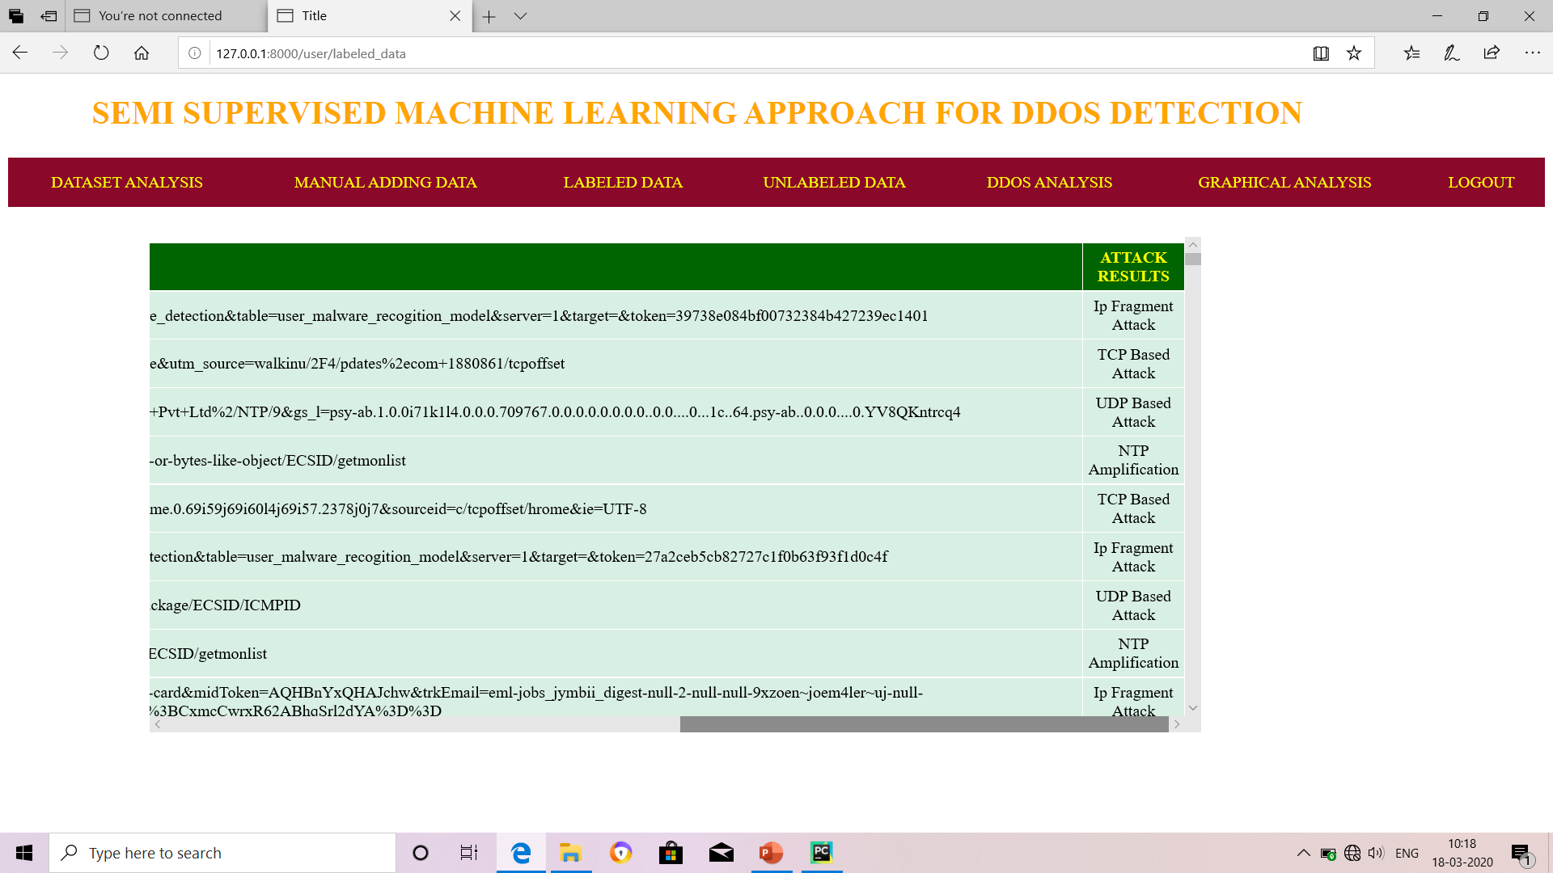
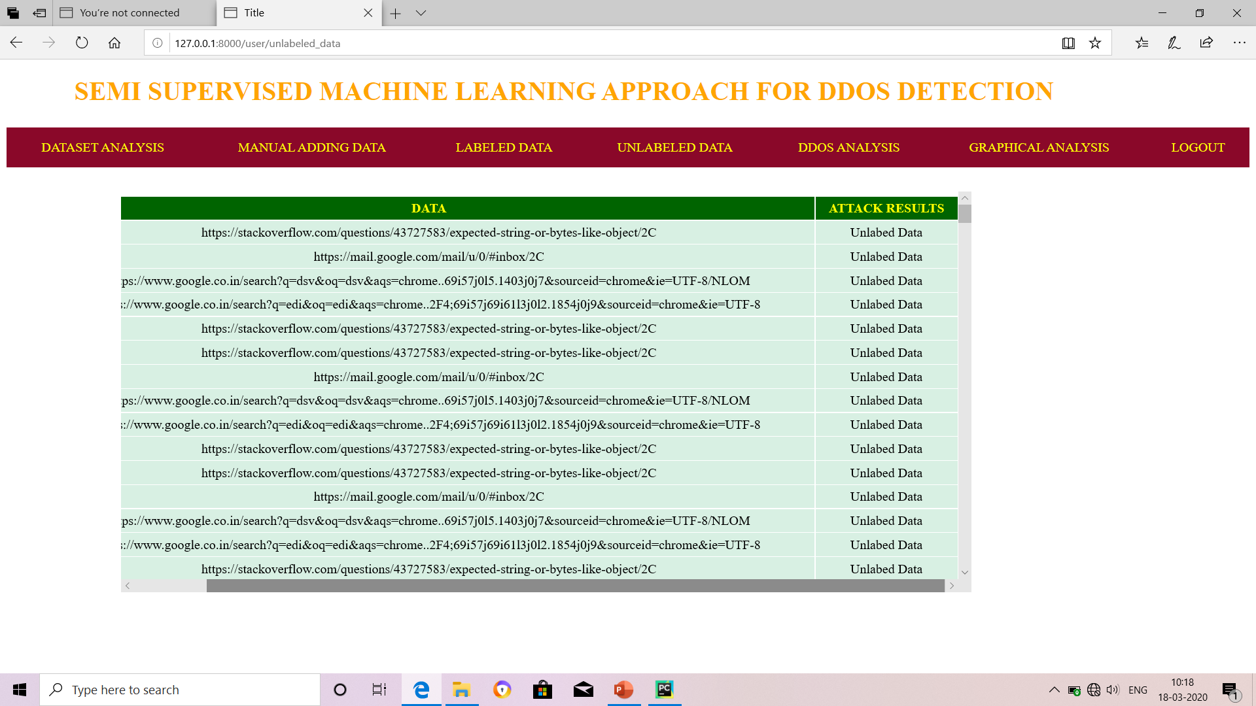

Slide 18
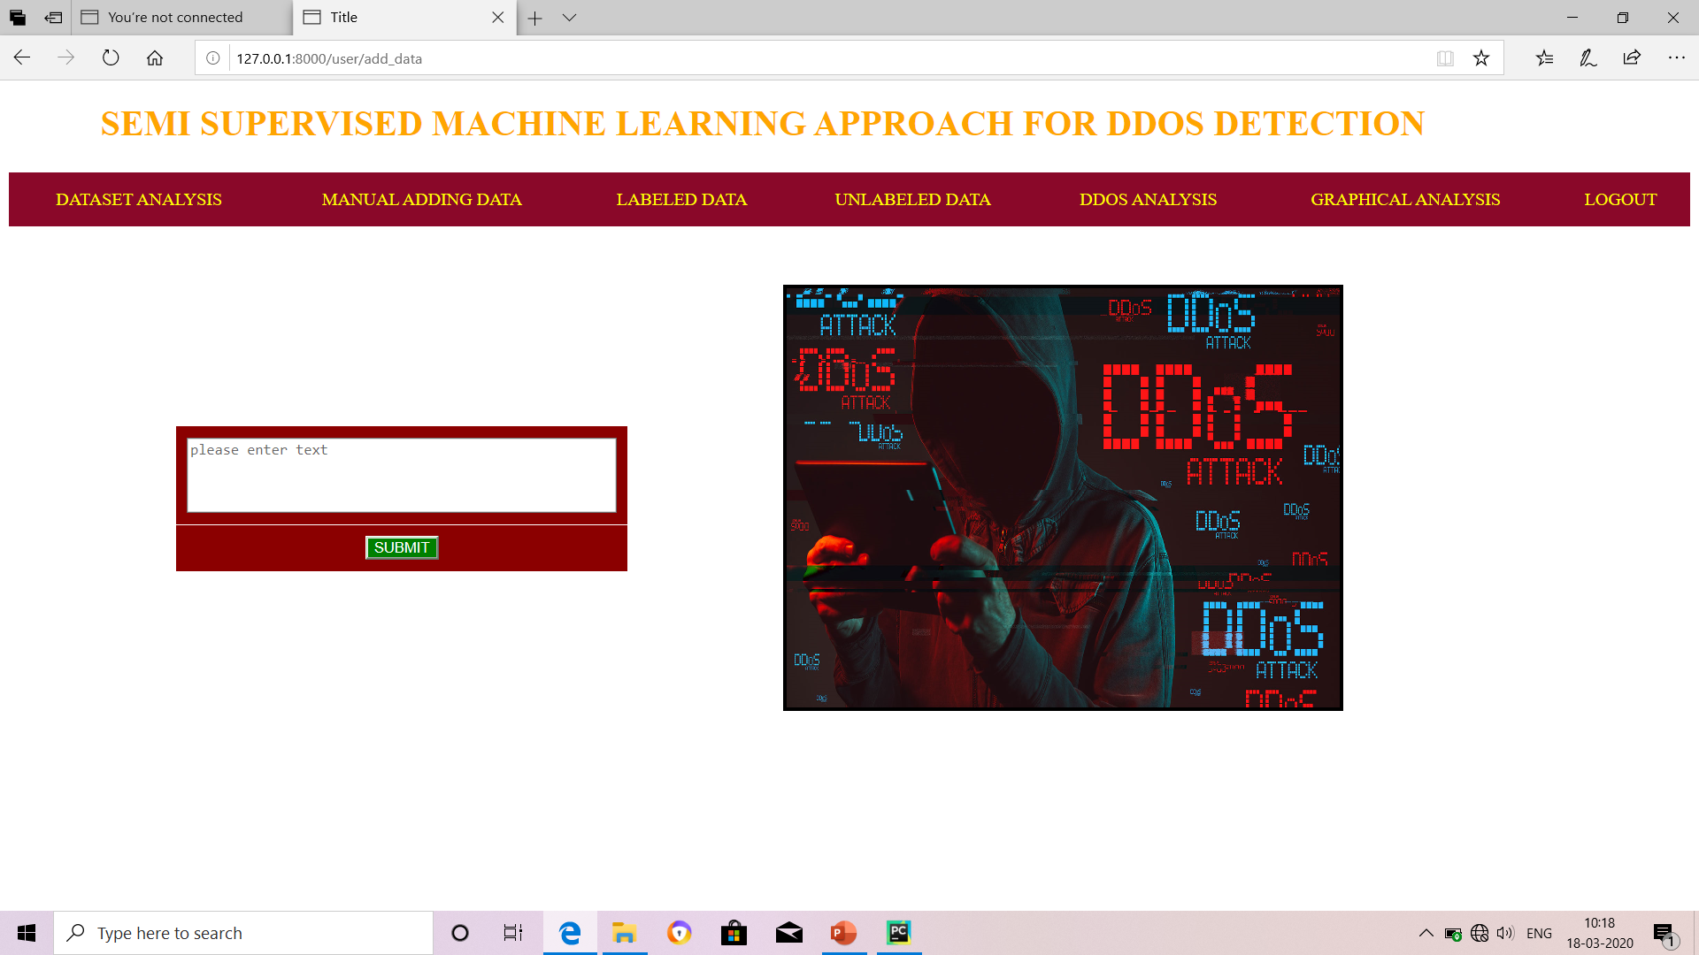

Slide 19
Thank you
Queries
?

